Slide 1
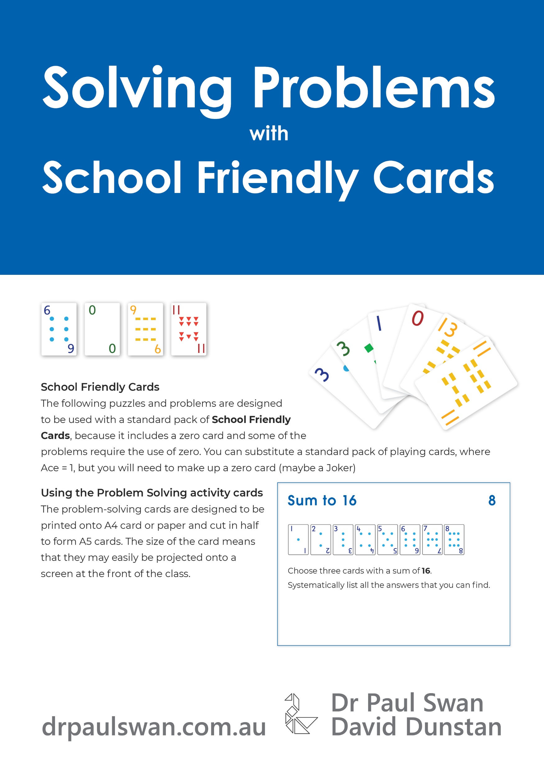
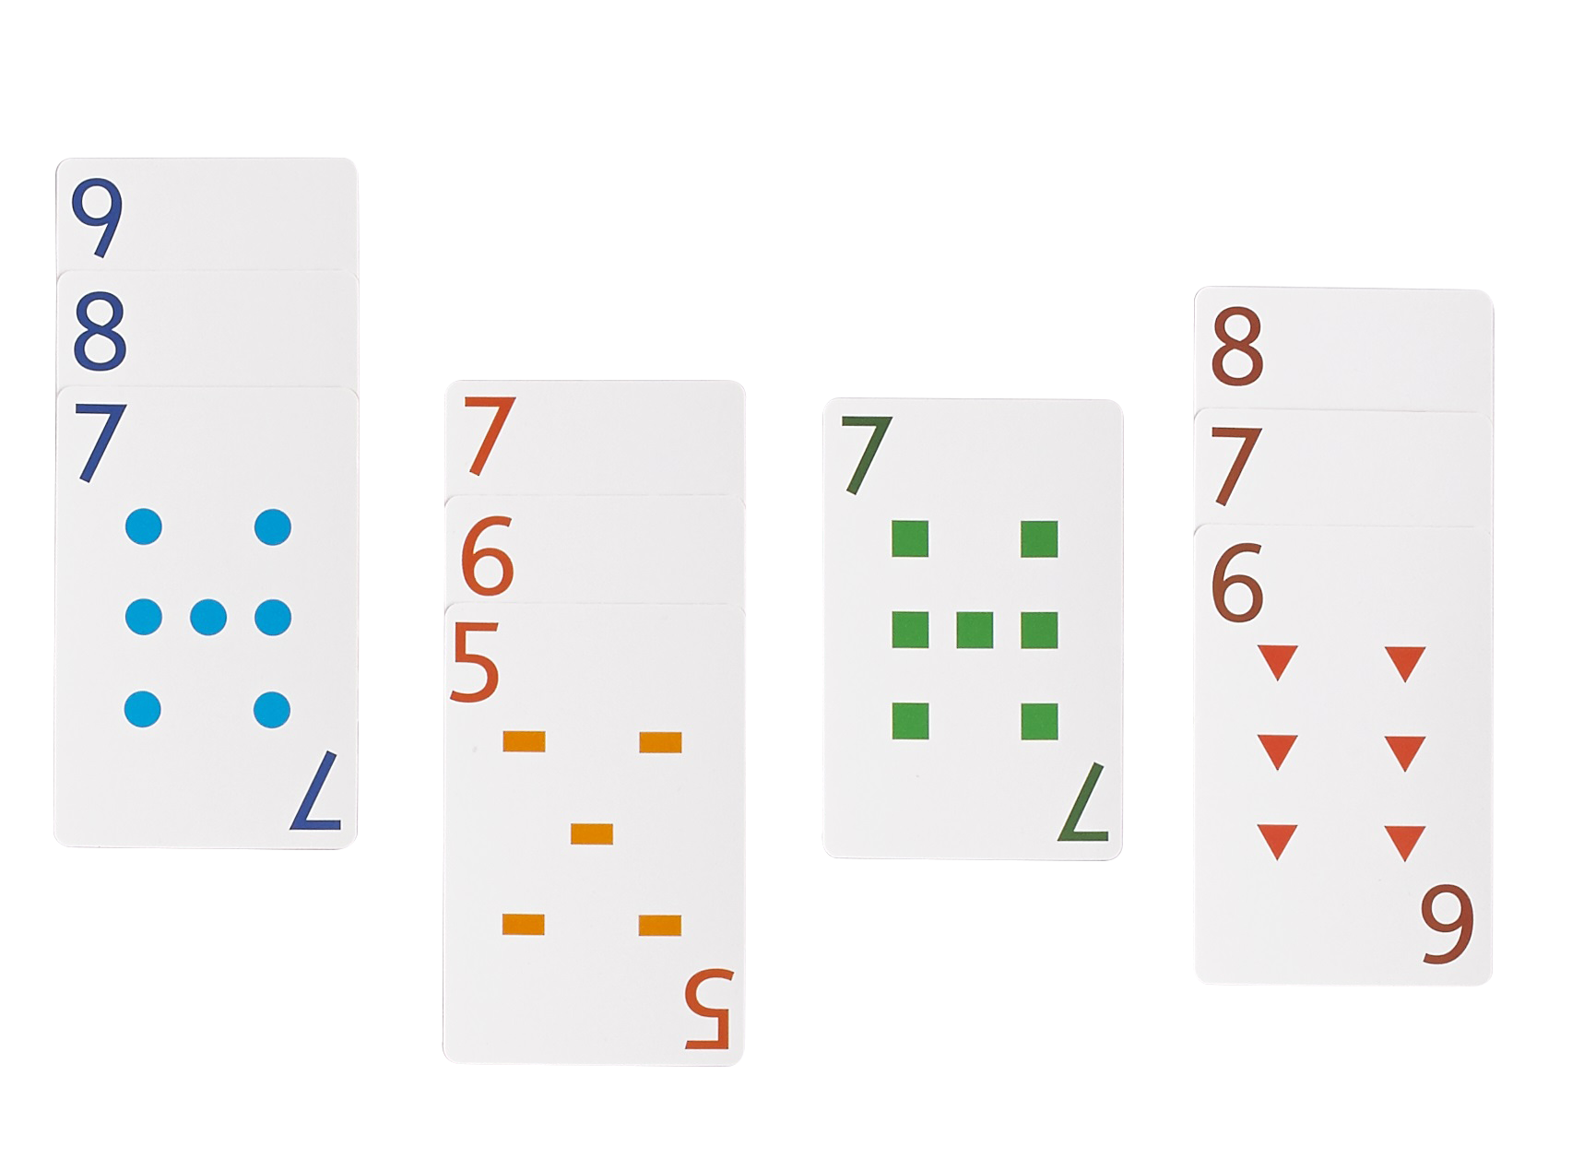
Solving Problems with School Friendly Cards
You will need:
The Solving Problems with School Friendly Cards free downloadable booklet
A pack of school friendly or normal cards
pen & paper
Dr Paul Swan & David Dunstan
www.drpaulswan.com.au

Slide 3
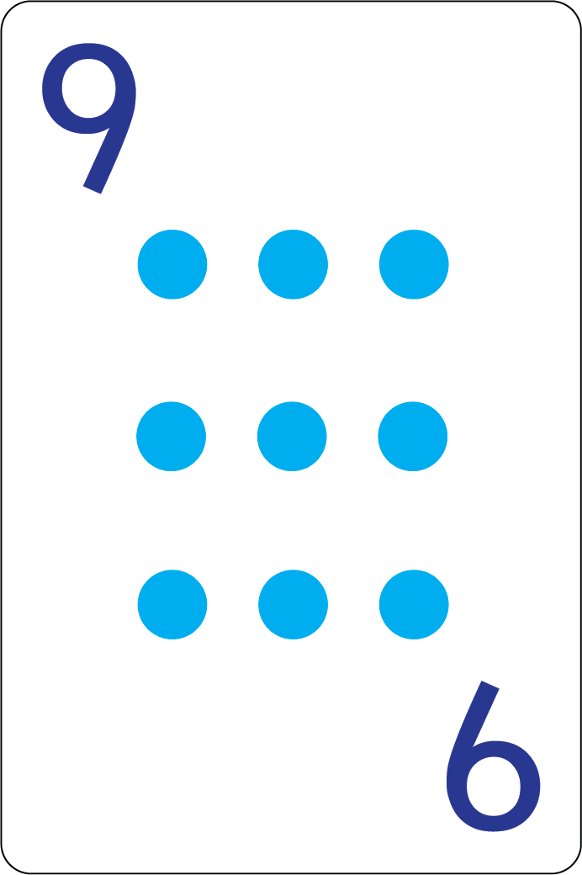
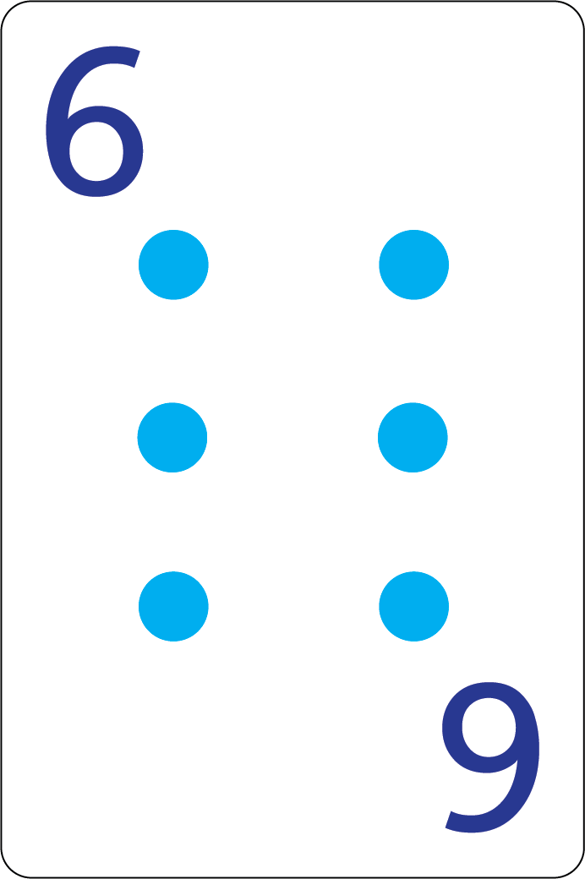
Problem 1 Answers

Slide 5
Problem 2 Answers

Slide 7
Problem 3 Answers

Slide 9
Problem 4 Answers

Slide 11
Problem 5 Answers

Slide 13
Problem 6 Answers

Slide 15
Problem 7 Answers

Slide 17
Problem 8 Answers

Slide 18
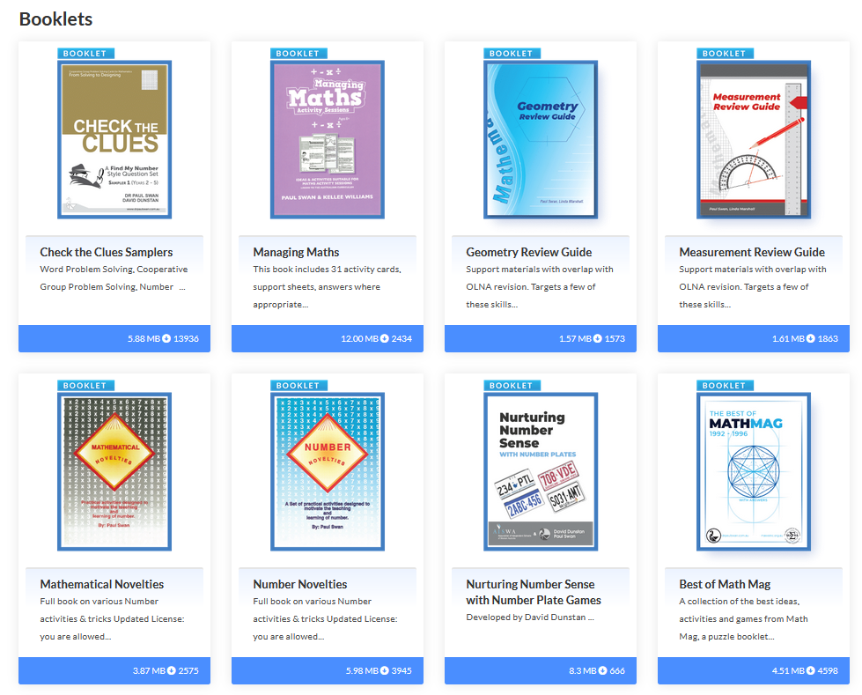
Free Downloads and Materials
www.drpaulswan.com.au/resources

